Slide 1
Pneumonia
Detection Analysis
Winston Chen, Yongxin Li, Connor Quinn, Justin Aboud
Automated methods to detect and classify human diseases from medical images.

Slide 2
table of contents
01
02
03
04
05
06
Abstract+
Methodology
Big data tools
Exploratory Data Analysis
Conclusion
Machine learning + Deep Learning
Evaluation +
DEMO
Automated methods to detect and classify human diseases from medical images.

Slide 3
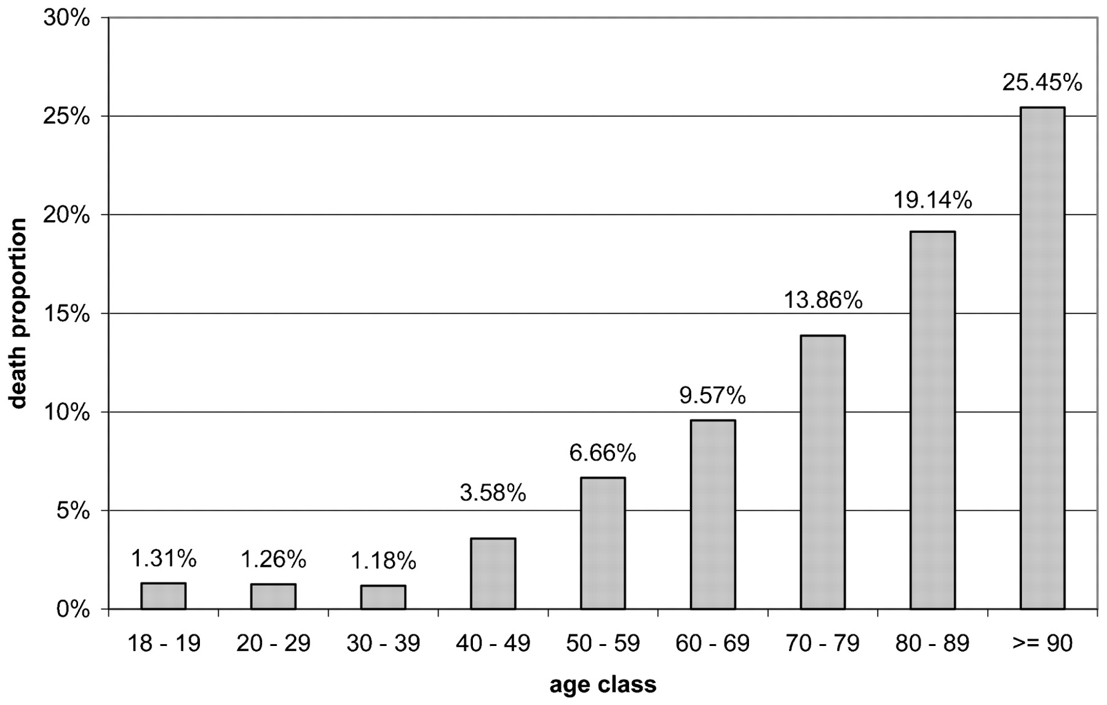
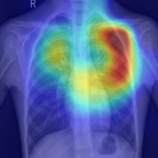
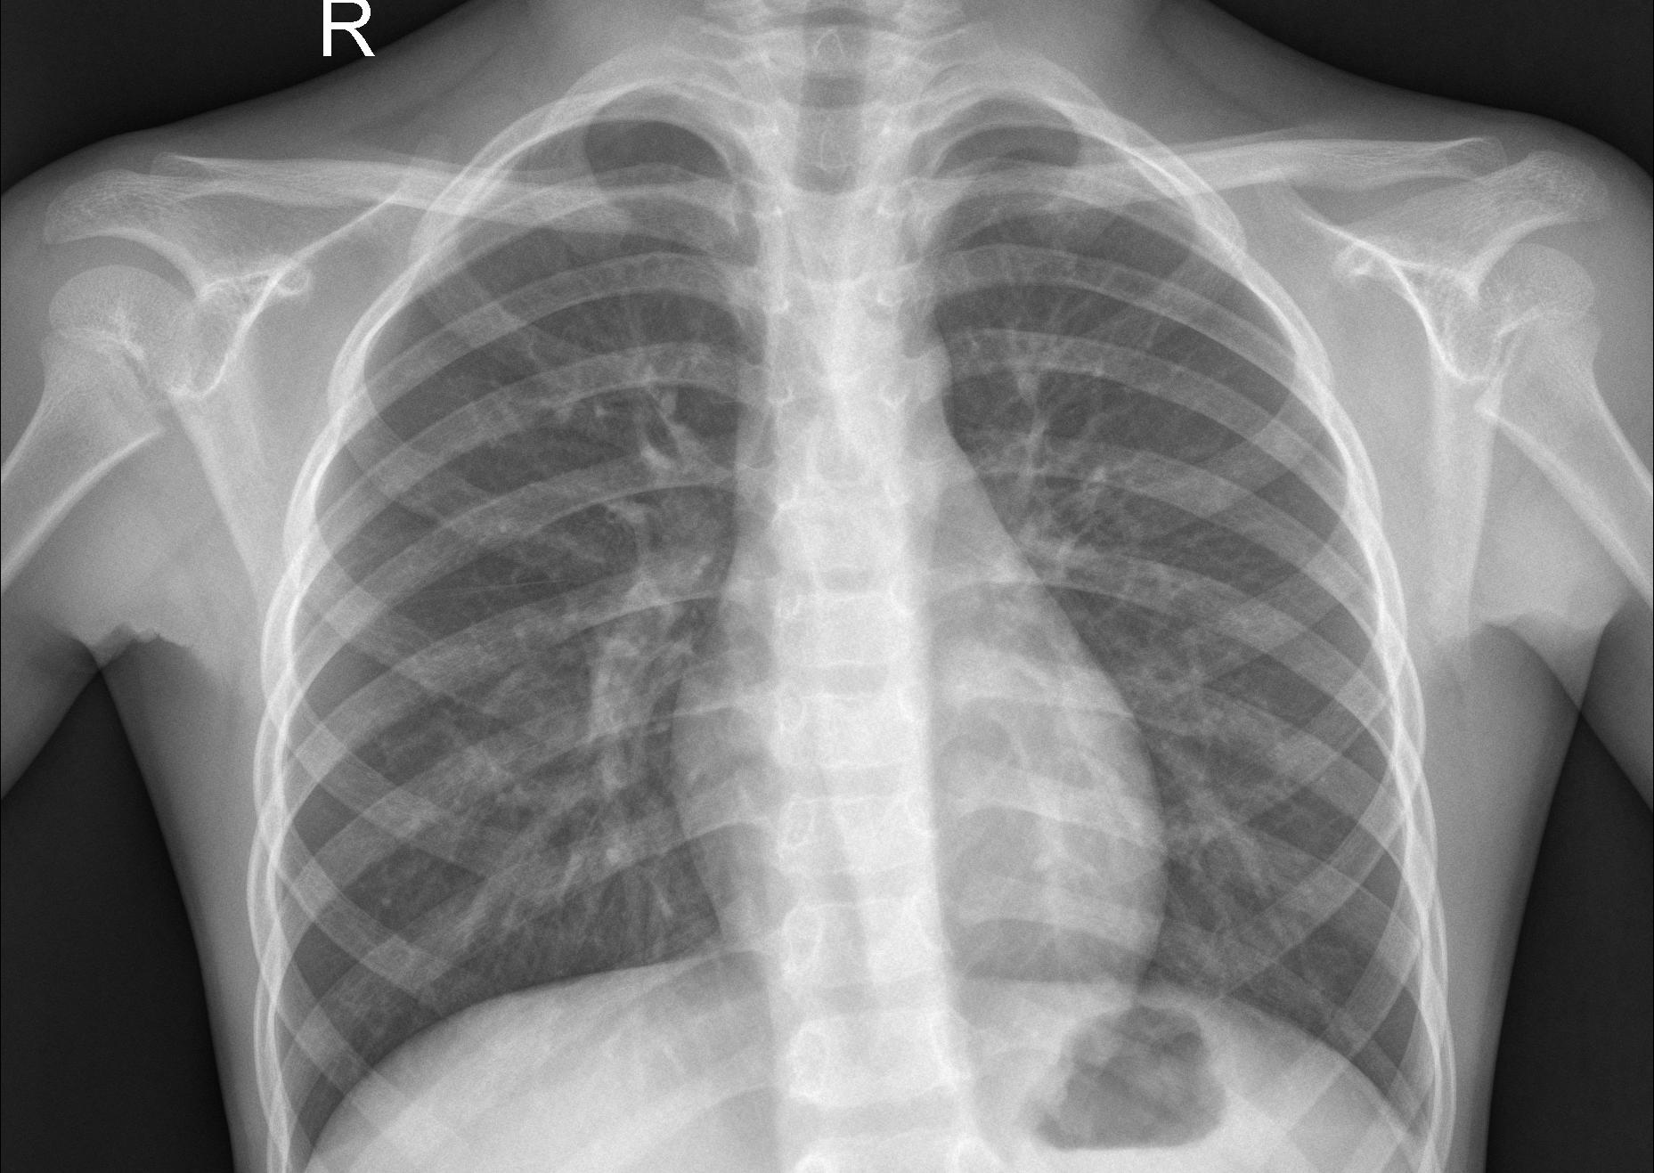
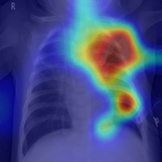
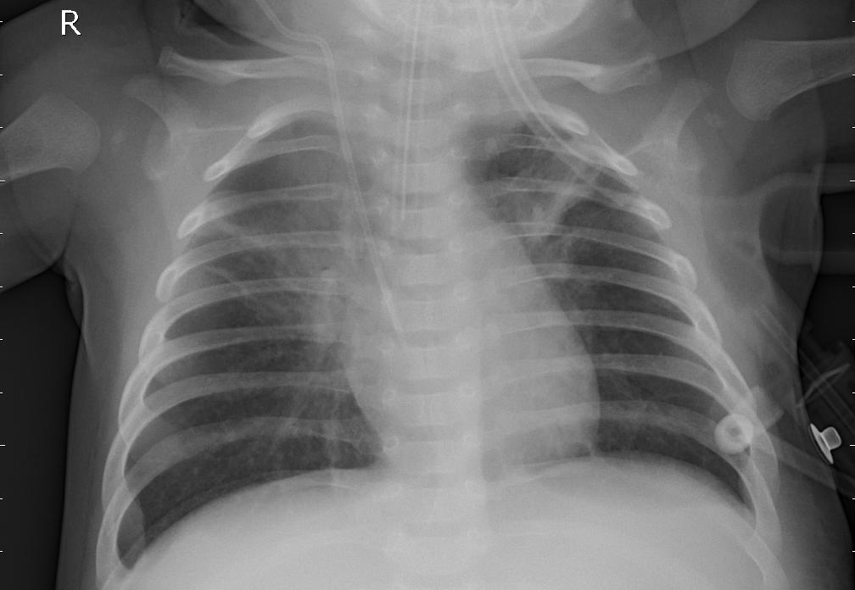
Abstract
Research Problem
Pneumonia is a severe lung infection that can be life-threatening, especially for children and elderly individuals. Early detection through chest X-rays is crucial for effective treatment.
Can you tell if any particular chest X-ray has Pneumonia? Only specialized doctors/radiologists can somewhat accurately tell.
Pneumonia Mortality Rate by Age
Heatmaps done by GradCAM
Solution
1.
2.
Develop a model that can screen X-ray images for Pneumonia for anyone!
?
?
Normal!
Pneumonia!

Slide 4
Methodology
Acquire Data from Source
LR, CNN, SVM +
RESNET
Extract
ML/DL training
EDA+big data
Results
Perform EDA
Store (HDFS)
Preprocess (PySpark)
Model evaluation and conclusions
Automated methods to detect and classify human diseases from medical images.

Slide 5
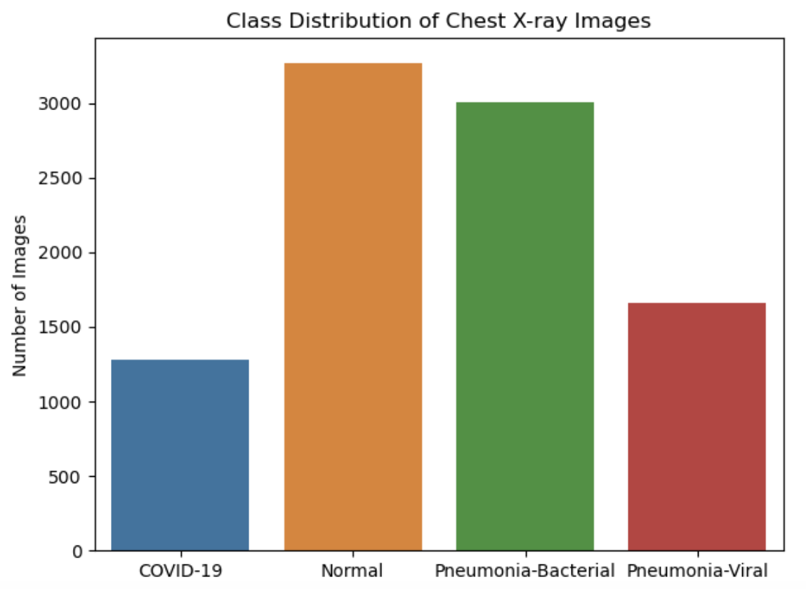
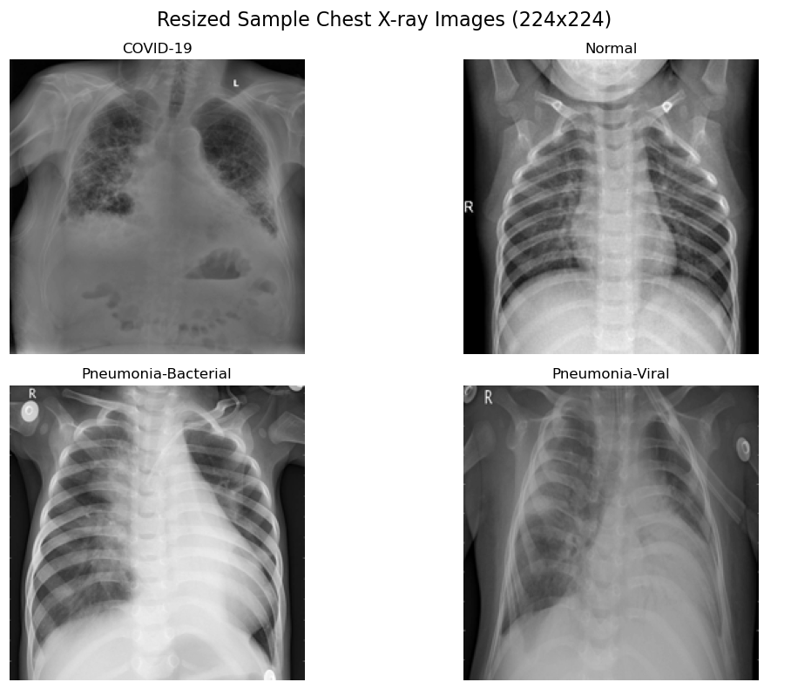
Exploratory Data Analysis
Class Distribution of Chest X-ray Images
Dataset Details
Image Counts
3.94 GB of .jpeg files of 3 kinds of Pneumonia with 1 ‘normal’ class
COVID-19: 1281
Normal: 3270
Pneumonia-Bacterial: 3001
Pneumonia-Viral: 1656
Total: 9208
Imbalanced! Will need strategies like class weighting: Covid and Pneumonia-Viral weighted more
Automated methods to detect and classify human diseases from medical images.

Slide 6
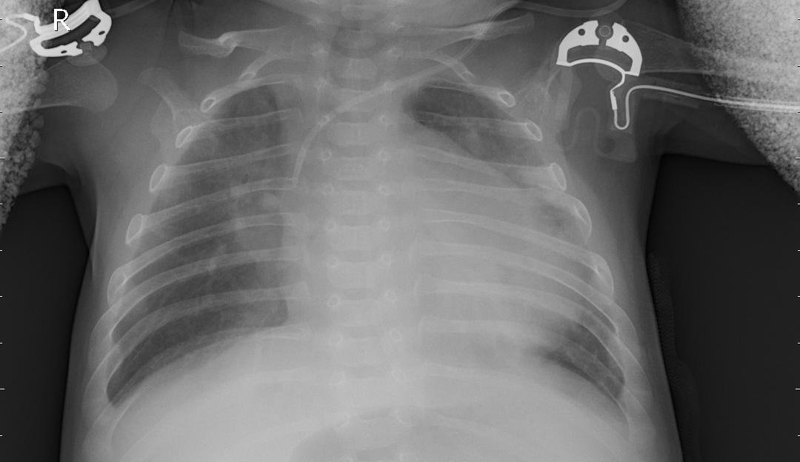
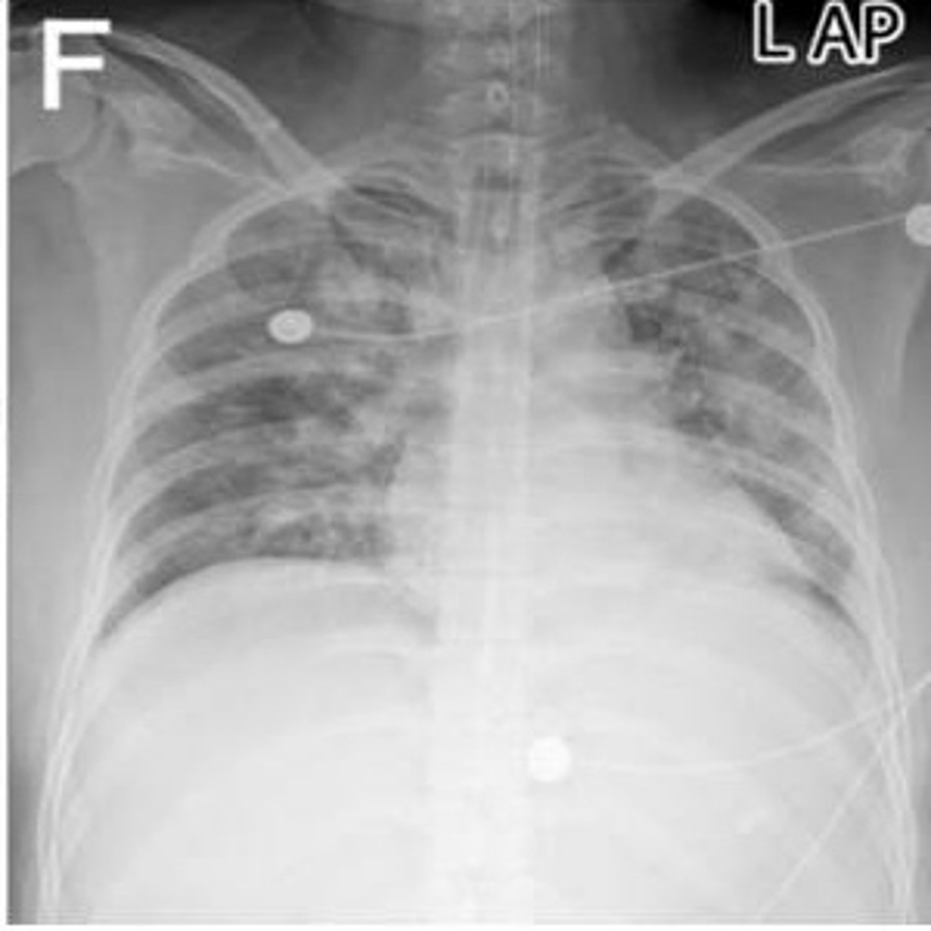
Exploratory Data Analysis
Chest X-Ray Examples
Dataset quirks
Greyscale
Different levels of Exposure
Annotations on images
X-Ray not consistently centered
Medical tools still in X-Ray
These traits must be addressed during preprocessing and model training!

Slide 7




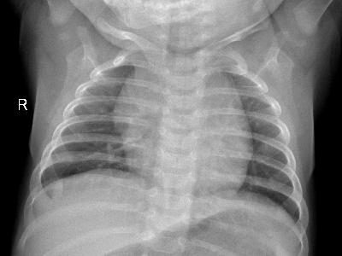
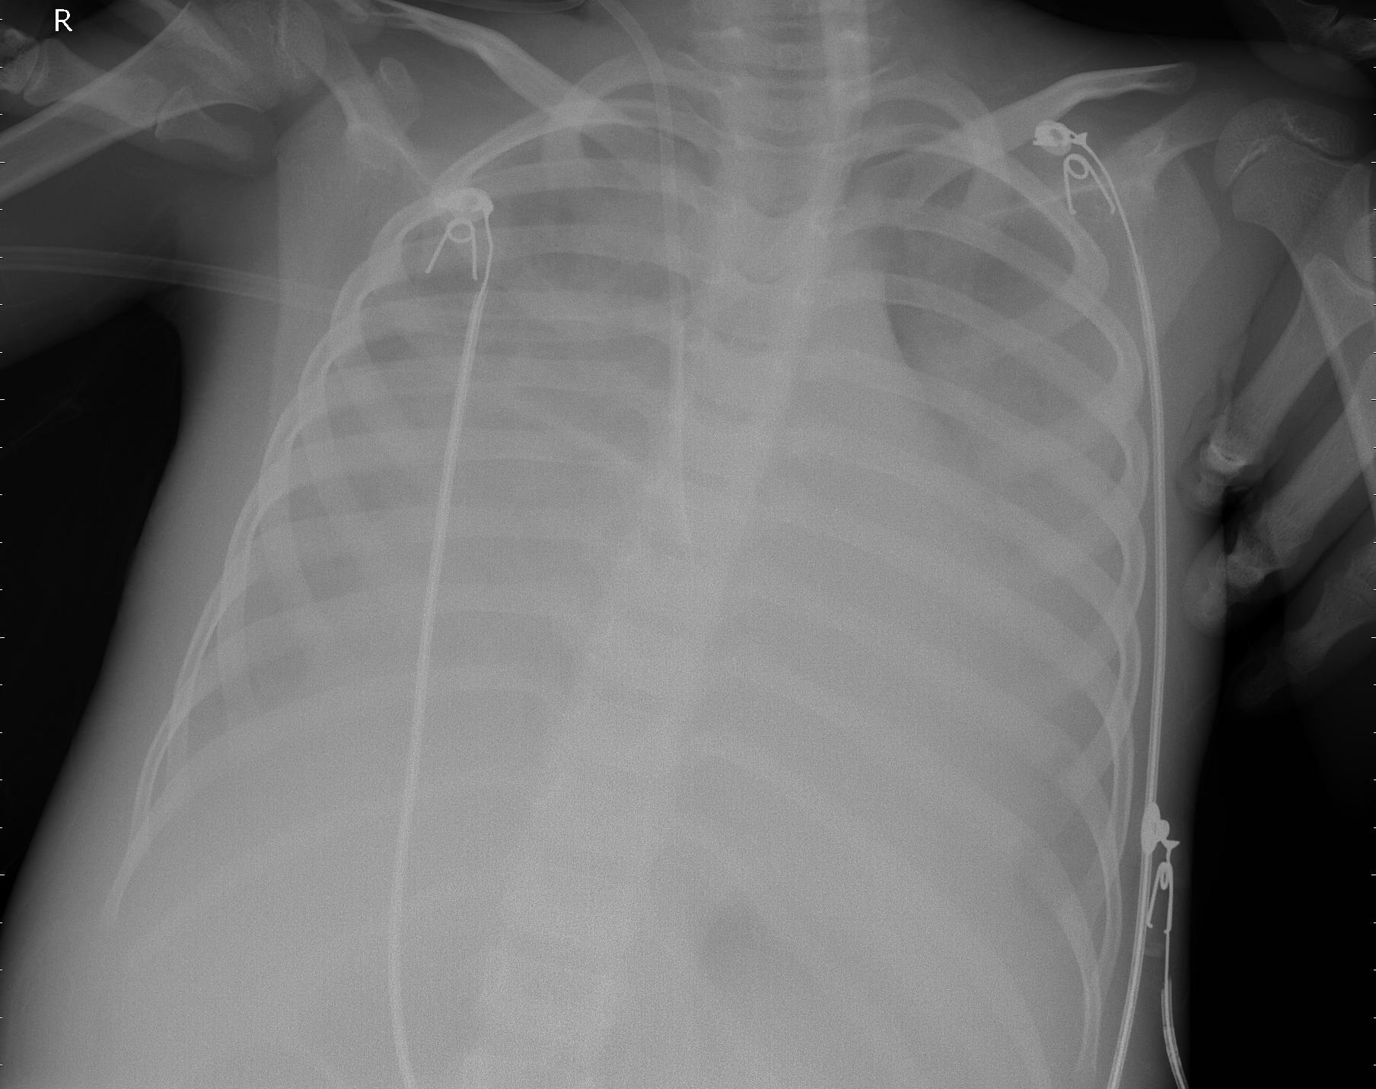
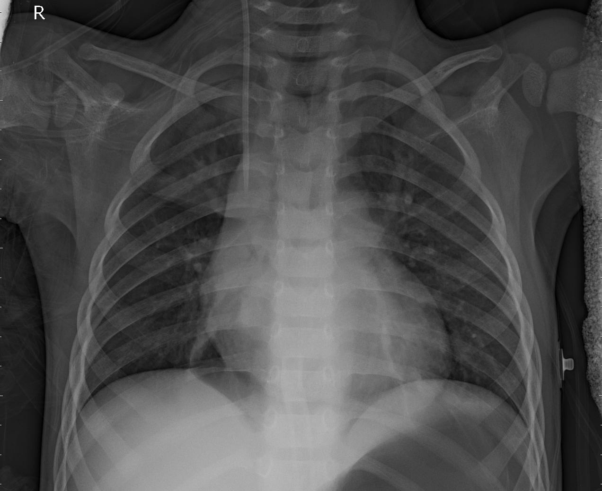
Big data tools
3 kinds of Pneumonia Dataset from Kaggle
Covid-19 Chest X-Ray images
Coalesced from 15 public datasets
Uploaded into HDFS
Same environment as PySpark
Crucial for storage and preprocessing due to parallelization
Covid
P. Viral
P. Bacterial

Slide 8
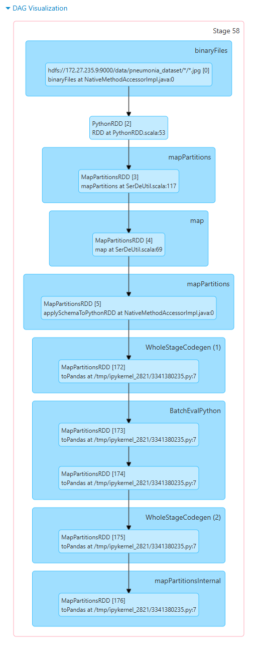
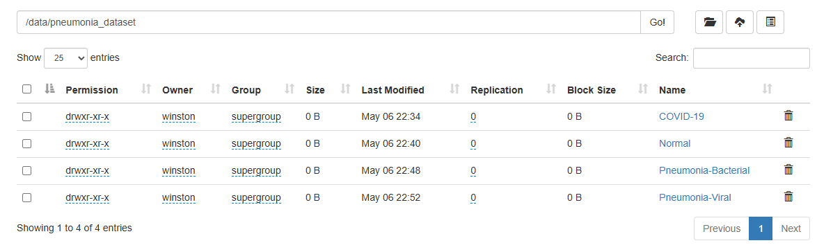
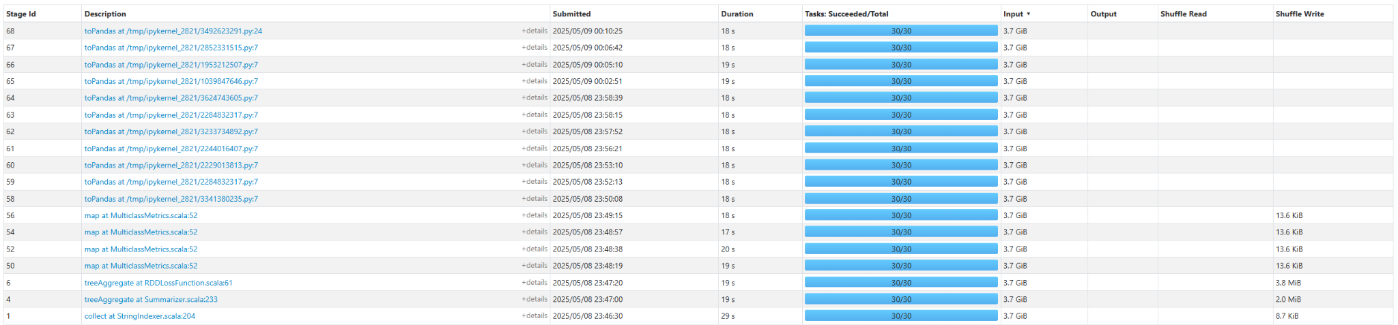
HDFS + Pyspark

Slide 9
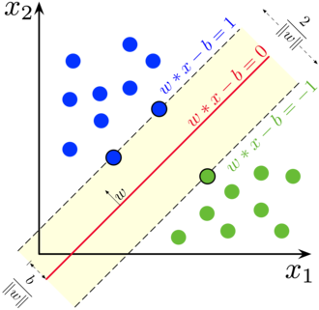
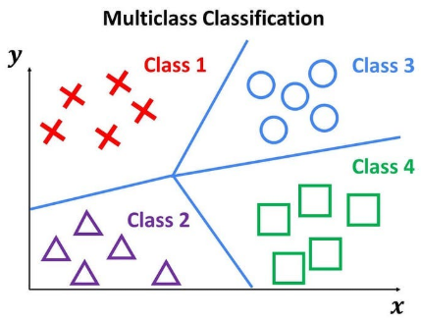

Machine learning
deep Learning
Convolutional Neural Network
Residual Neural Network
Support Vector Machines
Multi-class Logistic Regression

Slide 10
why not only Baseline ML, but also CNN?
 | SVM with big image data: | LR with big image data: | CNN with big image data:
✅Pro | Handles nonlinear data Good with high dimensional data Resilient to Overfitting | Simple & interpretable Computationally efficient Effectively handles binary and multi class Fast to train | Excellent at Feature Extraction Highly scalable Preserved image structure (2D) Robust to noise
❌Con | Ignores image structure (2D → 1D) Sensitive to noise Computation time Scales with data size | Sensitive to Outliers Linear Decision Boundary not suited for images Overfitting issues Ignores image structure (2D → 1D) | Scaling up performance requires scaling up depth Risk of overfitting w/o regularization Harder to interpret Slow to train
Notes:
measures the similarity between two data points based on their Euclidean distance and is known for its ability to map data into higher-dimensional spaces, allowing for the modeling of complex, non-linear decision boundaries.

Slide 11
Solution: hybrid model
Hybrid Model – SVM & CNN
SVM output verification: measure the accuracy of SVM predictions for initial screening, focus on recall to minimize FN
CNN verification on Filtered Data: sample that ‘positive’ from SVM, then use CNN for precise classification, measure CNN’s accuracy and metrics for this subset of data.
Resnet is a residual neural network, a type of CNN that uses skip connections to avoid the vanishing gradient problem that comes with regular neural networks, while still allowing a model to extract details from the image.
Pipeline Evaluation :
Combine outputs of SVM, CNN for test set
Analyze end-to-end confusion matrix for hybrid predictions.
Evaluate overall accuracy, precision, recall, f1-score of the hybrid system
Automated methods to detect and classify human diseases from medical images.

Slide 12
Primary Hypothesis
Secondary Hypotheses
Residual neural networks achieve exceptional computer vision performance, at the cost of being very large, and having high inference times.
We believe that using a binary classification ml algorithm to screen healthy cases, will allow a larger resnet to achieve better performance at scale.
We are additionally curious to see how introducing the binary classification will impact accuracy.
We hypothesize that two things may happen
Reducing the number of classes/ filtering healthy cases improves network performance on sick cases.
The filter eventually becomes outperformed by the network, and introduce error that may not be present in the baseline network.

Slide 13
Model Setup + Preprocessing
Logistic Regression
Run on PySpark MLLib
(in WSL with HDFS)
Images resized to 64x64 due to memory constraints
80-20 Train/Test split
PySpark LR
Convolutional Neural Network
6 Conv x 1 GAP x 2 FC
20 Epochs
Class Weighting for minority
Data augmentation with Kornia
Images resized to 224x224
70-15-15 Train/Val/Test split
Hybrid SVM + ResNet
Modified Pytorch 34 layer Resnet (multi)
Sklearn SVM (binary)
Up to 100 Epochs
Class Weighting for minority
Data augmentation with Kornia
Images resized to 224x224
80-180 Train/Test split

Slide 14
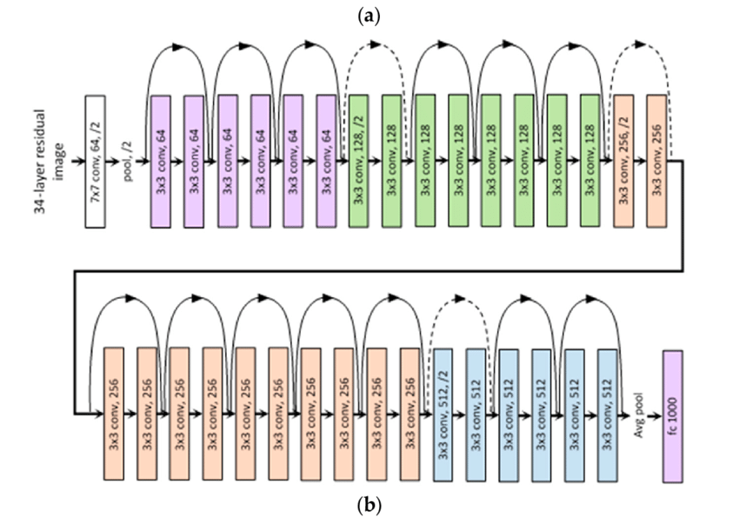
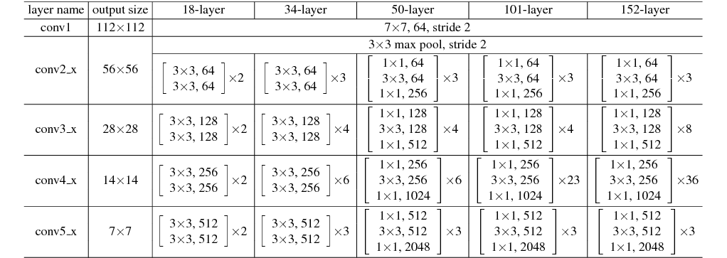
Resnet diagram and table
Convolutional neural networks extract features, but can lose context of the original image due to disappearing gradient. Resnet is divided into blocks consisting of [convolution layer, batch norm, relu, convolution layer, batch norm], and solves the disappearing gradient problem with residual skip connections passing the input of the block forward to the block output, since they are the same size, and reintroduce the contextual information. A block has 2 convolution layers and as you can see in the diagram, the residual connections go from the beginning of one layer to the end of the next, or effectively, from the beginning to the end of the block

Slide 15
ResNet(
(conv1): Conv2d(1, 64, kernel_size=(7, 7), stride=(2, 2), padding=(3, 3), bias=False)
(bn1): BatchNorm2d(64, eps=1e-05, momentum=0.1, affine=True, track_running_stats=True)
(relu): ReLU(inplace=True)
(maxpool): MaxPool2d(kernel_size=3, stride=2, padding=1, dilation=1, ceil_mode=False)
(layer1): Sequential(
(0): BasicBlock(
(conv1): Conv2d(64, 64, kernel_size=(3, 3), stride=(1, 1), padding=(1, 1), bias=False)
(bn1): BatchNorm2d(64, eps=1e-05, momentum=0.1, affine=True, track_running_stats=True)
(relu): ReLU(inplace=True)
(conv2): Conv2d(64, 64, kernel_size=(3, 3), stride=(1, 1), padding=(1, 1), bias=False)
(bn2): BatchNorm2d(64, eps=1e-05, momentum=0.1, affine=True, track_running_stats=True)
)
(1): BasicBlock(...)
(2): BasicBlock(...)
)
(layer2): Sequential(
(0): BasicBlock(
(conv1): Conv2d(64, 128, kernel_size=(3, 3), stride=(2, 2), padding=(1, 1), bias=False)
(bn1): BatchNorm2d(128, eps=1e-05, momentum=0.1, affine=True, track_running_stats=True)
(relu): ReLU(inplace=True)
(conv2): Conv2d(128, 128, kernel_size=(3, 3), stride=(1, 1), padding=(1, 1), bias=False)
(bn2): BatchNorm2d(128, eps=1e-05, momentum=0.1, affine=True, track_running_stats=True)
(downsample): Sequential(
(0): Conv2d(64, 128, kernel_size=(1, 1), stride=(2, 2), bias=False)
(1): BatchNorm2d(128, eps=1e-05, momentum=0.1, affine=True, track_running_stats=True)
)
)
(1): BasicBlock(...)
(2): BasicBlock(...)
(3): BasicBlock(...)
)
(layer3): Sequential(
(0): BasicBlock(
(conv1): Conv2d(128, 256, kernel_size=(3, 3), stride=(2, 2), padding=(1, 1), bias=False)
(bn1): BatchNorm2d(256, eps=1e-05, momentum=0.1, affine=True, track_running_stats=True)
(relu): ReLU(inplace=True)
(conv2): Conv2d(256, 256, kernel_size=(3, 3), stride=(1, 1), padding=(1, 1), bias=False)
(bn2): BatchNorm2d(256, eps=1e-05, momentum=0.1, affine=True, track_running_stats=True)
(downsample): Sequential(
(0): Conv2d(128, 256, kernel_size=(1, 1), stride=(2, 2), bias=False)
(1): BatchNorm2d(256, eps=1e-05, momentum=0.1, affine=True, track_running_stats=True)
)
)
(1): BasicBlock(...)
(2): BasicBlock(...)
(3): BasicBlock(...)
(4): BasicBlock(...)
(5): BasicBlock(...)
)
(layer4): Sequential(
(0): BasicBlock(...
(downsample): Sequential(
(0): Conv2d(256, 512, kernel_size=(1, 1), stride=(2, 2), bias=False)
(1): BatchNorm2d(512, eps=1e-05, momentum=0.1, affine=True, track_running_stats=True)
)
)
(1): BasicBlock(...)
(2): BasicBlock(...)
)
(avgpool): AdaptiveAvgPool2d(output_size=(1, 1))
(fc): Linear(in_features=512, out_features=4, bias=True)
)
Resnet34 starts out with a convolution layer with a 7x7 kernel, then batchnorm for normalization, and relu for activations. Then it has sections (in the code they are referred to as layers) each consisting of residual blocks [convolution layer, batch norm, relu, convolution layer, batch norm] at the beginning of each section besides the first, you can see that it uses strided convolution to downsample at the beginning of each section, and at the end it has to downsample the input again for the residual skip connection.

Slide 16
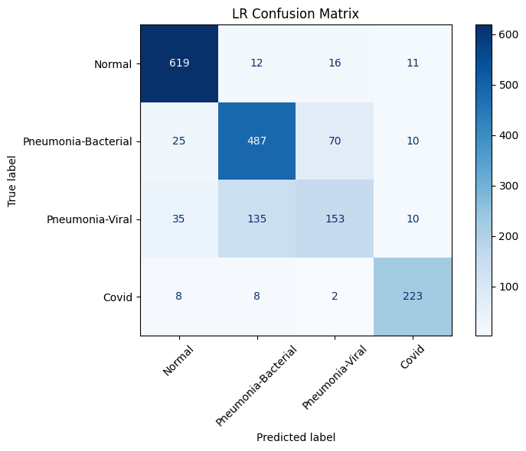
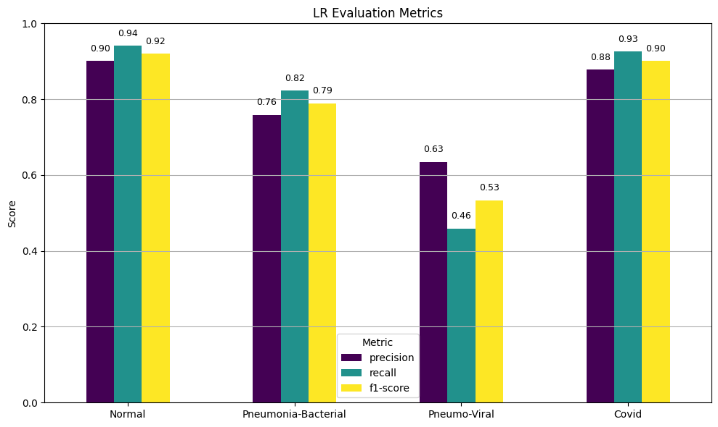
Logistic Regression
model results
Logistic Regression Confusion Matrix
Struggles to discern the Pneumonia variants
Indicates Normal/Covid is easy to spot, but Bacterial vs Viral is more subtle

Slide 17
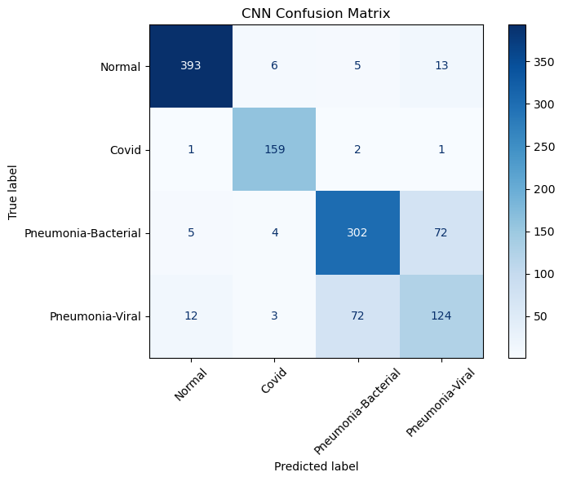
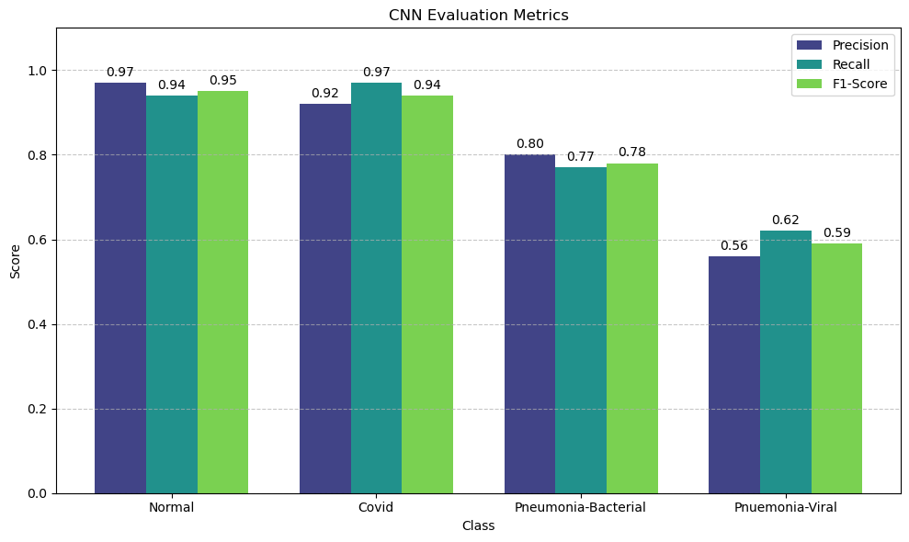
Cnn model results
CNN Confusion Matrix
Shallower network at 6 conv layers
No skip connections, vanishing gradient may be a problem
Not enough augmentation to overcome noise?

Slide 18
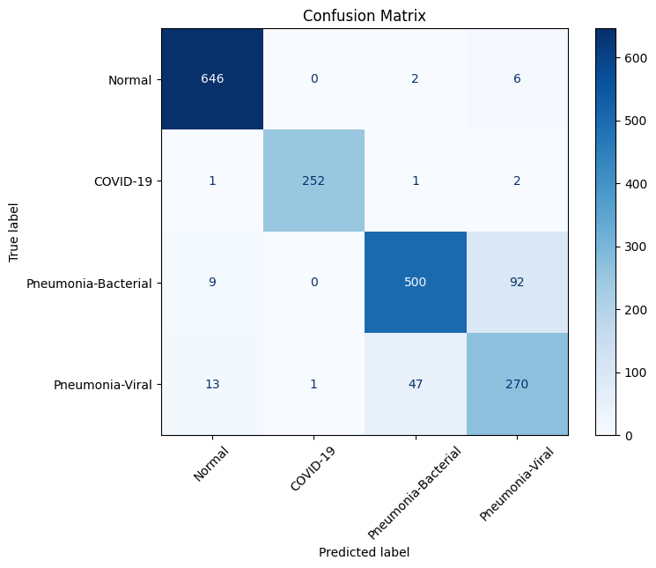
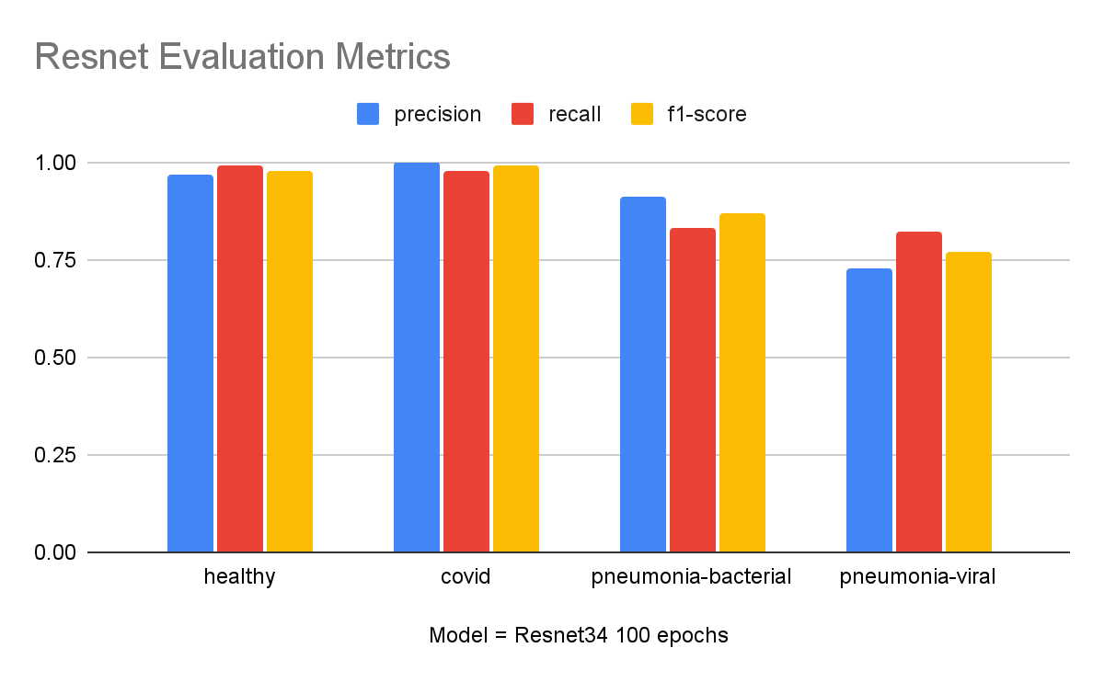
Baseline Resnet Model Results
Baseline Resnet Confusion Matrix

Slide 19
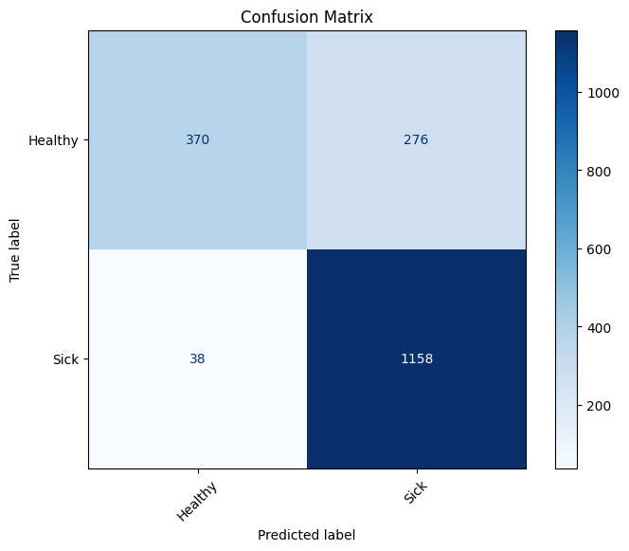
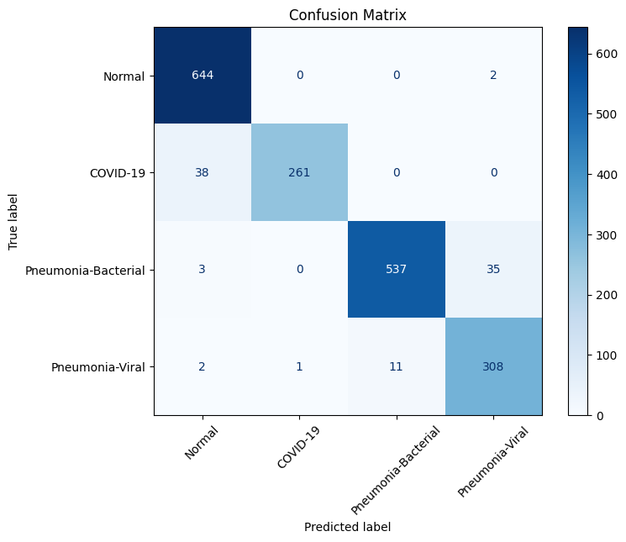
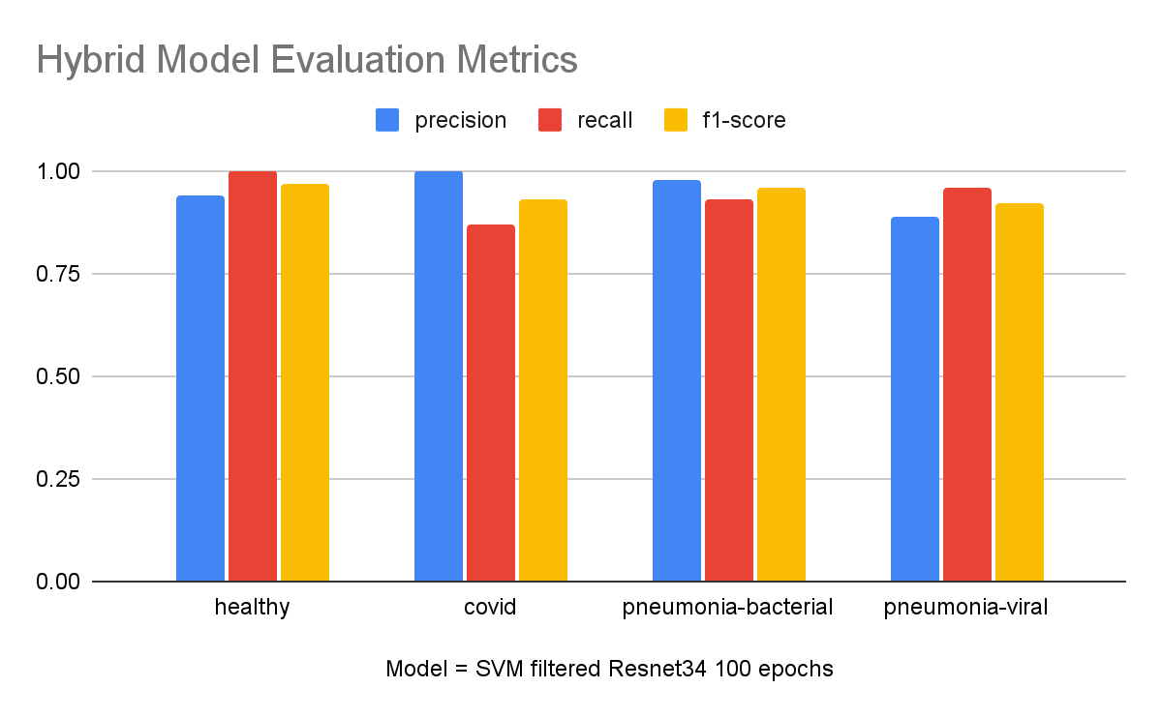
Hybrid svm+Resnet
model results
SVM Confusion Matrix
We selected the SVM configuration that showed the best recall
As you can see, only 38 out of 1196 sick patients were misclassified
False Negatives are the worst outcome for disease diagnosis
Hybrid SVM + ResNet Confusion Matrix

Slide 20
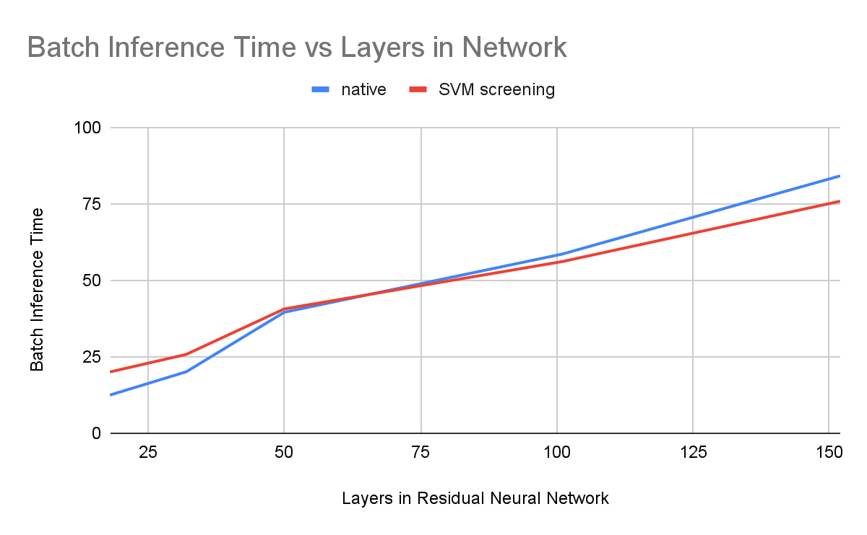
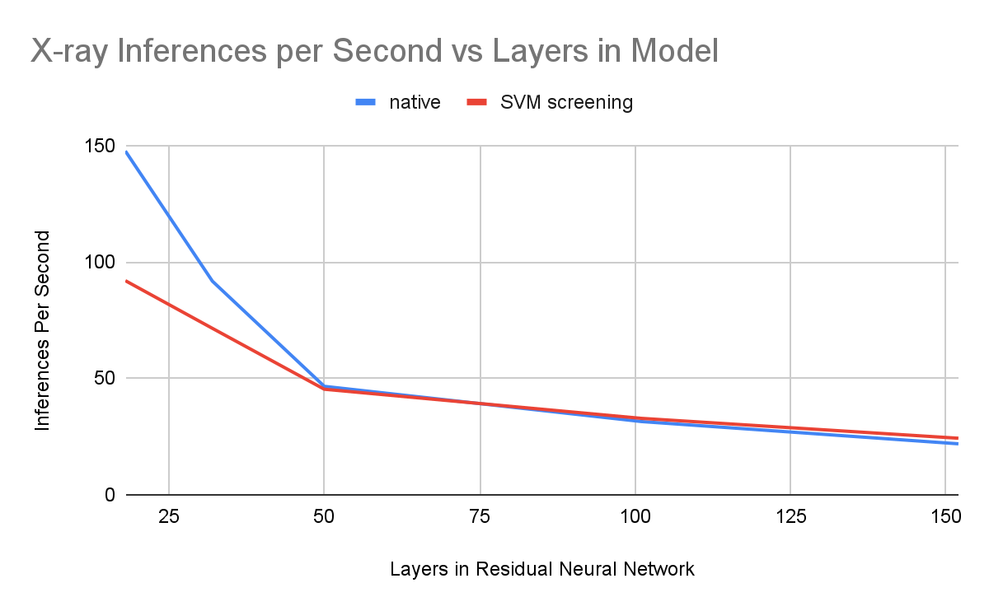
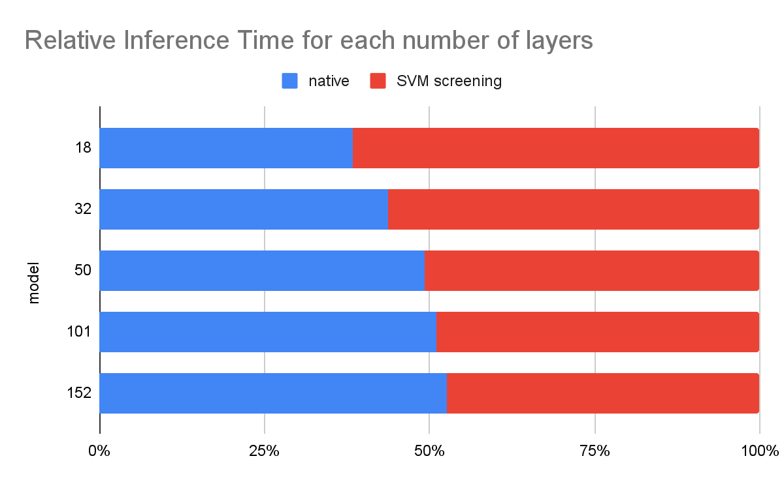
Conclusions – primary Hypothesis
Our primary Hypothesis appears to be True.
While shallower resnets might run inference faster than the shallow hybrid networks, we can see that when the depth increases the inference speed of the hybrid network exceeds that of the normal network.
Because SVM’s speed is independent of the number of layers, as the computation of the resnet grows, SVM does not, resulting in less computation and faster inference.

Slide 21
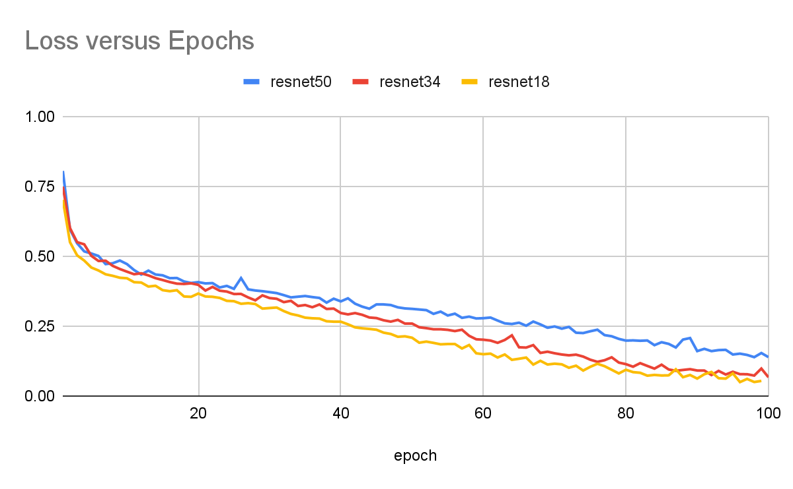
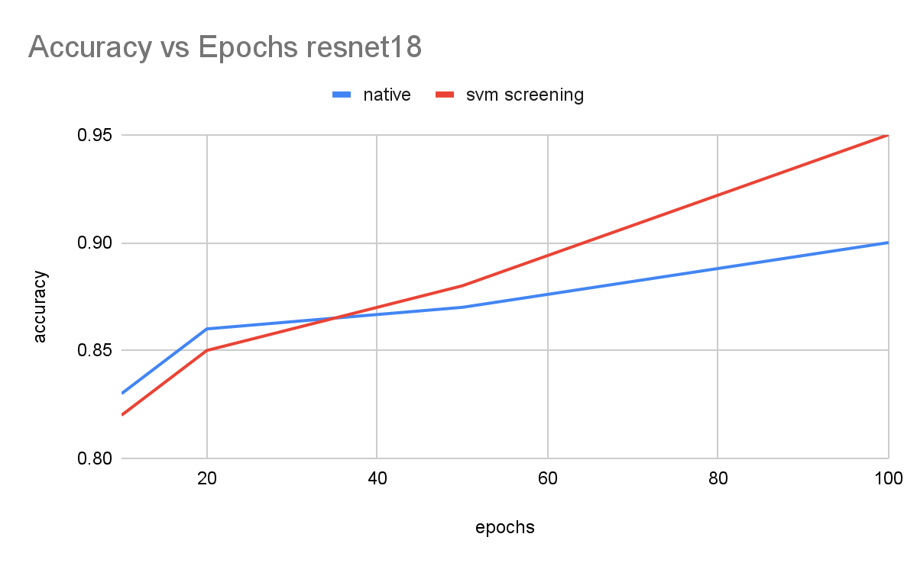
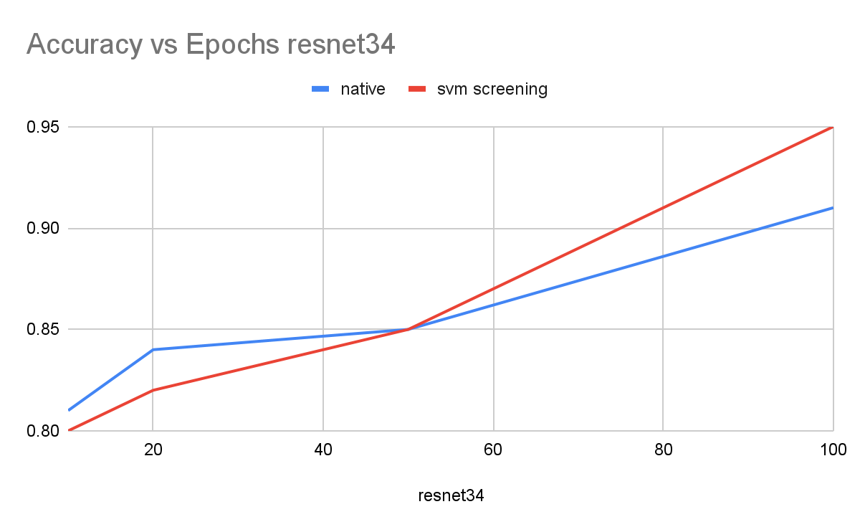
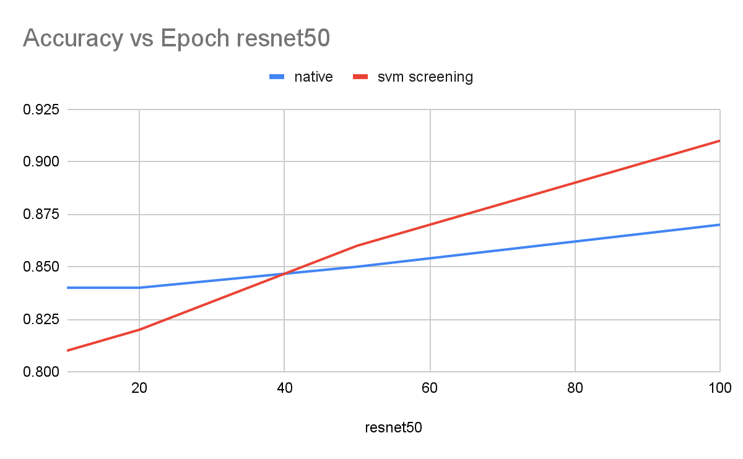
Conclusions – Secondary Hypothesis
Our first secondary hypothesis appears to be True, we find that our hybrid model, given enough time to train, performs better than the standard resnet.
Our best performing models were the resnet18 and resnet 34 hybrids when trained to 100 epochs, each achieving 95% in accuracy.
Our other secondary hypothesis is also True. The SVM starts to become a limiting factor when the model gets larger. Our hybrid model was misclassifying 38 covid cases (the exact number of misclassifications of the SVM) as opposed to only 1 by the control.

Slide 22
Demo: chest x-ray classifier
Upload an image of a chest x-ray for a quick diagnosis!

Slide 23
RESOURCES
Dataset
https://data.mendeley.com/datasets/9xkhgts2s6/3 <- cleaned version of the below dataset.
https://www.kaggle.com/datasets/artyomkolas/3-kinds-of-pneumonia/data
https://www.kaggle.com/datasets/paultimothymooney/chest-xray-pneumonia/data (for demo)
Images
https://thorax.bmj.com/content/64/12/1062
https://en.wikipedia.org/wiki/Support_vector_machine#/media/File:SVM_margin.png
https://en.wikipedia.org/wiki/Apache_Spark#/media/File:Apache_Spark_logo.svg
https://www.edureka.co/blog/hadoop-tutorial/
https://www.nature.com/articles/s41598-019-42557-4#citeas
Automated methods to detect and classify human diseases from medical images.

Slide 24
THANKS!
DO YOU HAVE ANY QUESTIONS?
Automated methods to detect and classify human diseases from medical images.

